Slide 1
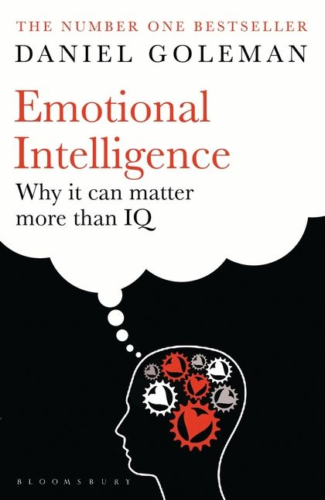
Manas K Mandal

Slide 2

You find out that the promotion you were hoping for was given to someone else
a. You forget about it. You didn't want the job that much anyway.
b. You lock yourself in your office and cry.
c. You obsess over what the other person had that you didn't and compare yourself to him or her unmercifully.
d. You continue to do your best; you know the next promotion is yours.
http://quiz.ivillage.co.uk/cgi-bin/uk_work/tests/eqtest.cgi

Slide 3
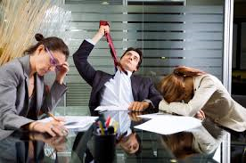
You are in a meeting when a colleague takes credit for the work you have done. What do you do?
Immediately confront the colleague saying that you did the research?
After the meeting, take the colleague aside & tell him/her that in the future you would appreciate credit for the work you did.
Nothing. It’s best not to embarrass colleagues in public.
After the colleague speaks, publicly thank him/her for referencing your work & provide additional details

Slide 4
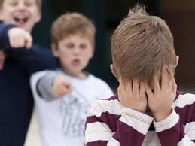
When someone you respect humiliates you by making a crack in front of others about a mistake you’ve made, you..
Go home & vow never to put yourself in such situation
Make a sharp comeback
Go home & write a letter to defend your position
Make light of it, if you can and then privately tell the person how you felt

Slide 5
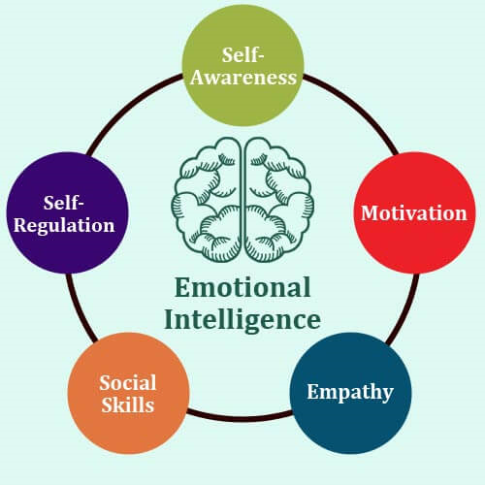
…Emotional awareness about self & ability to mange oneself
…Social awareness about others & ability manage relationships

Slide 6


…awareness about self
Who am I ? What is my identity?
Do I understand myself in real time?
Do I have access to my inner thoughts, desires in life?
Is my life a choice? How do I make choices in life?
Am I more ego-centric than eco-centric?

Slide 7
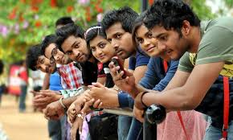
Why others are important in our lives?

Slide 8

How do we develop connectedness with others?

Slide 9
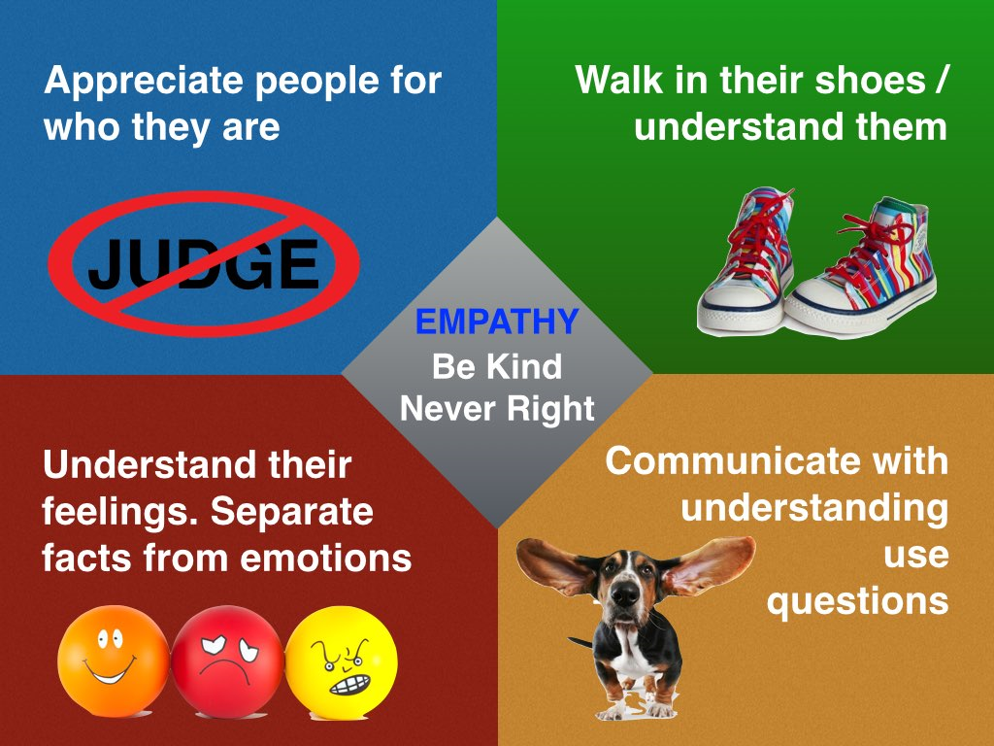
Feeling about the inner life of another…Empathy

Slide 10
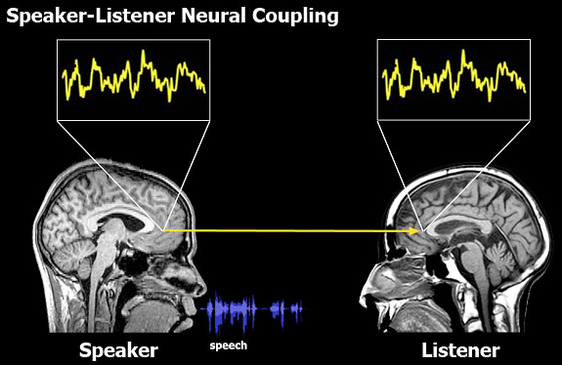
Building empathy by listening to stories…

Slide 11
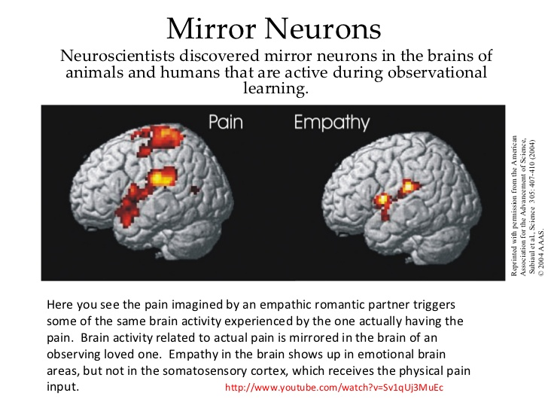

Slide 12

Head or Heart?
Are these parts friends?
Is one part the boss?
How do these two communicate with each other?
How do they react in the event of disagreement?

Slide 13
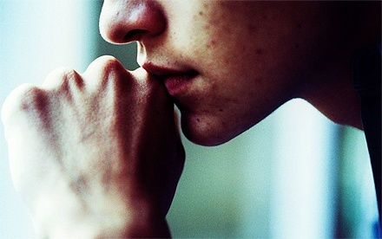
Persons with Low EI
I am too sensitive; take everything personally
I don’t know as to why I become depressed at times
I believe I have suffered most in the workplace
I am not sure what my boss feels about me
I express my feelings awkwardly in social situations
I find it difficult to handle pressure adequately
I find it difficult to interact with people of opposite sex

Slide 14
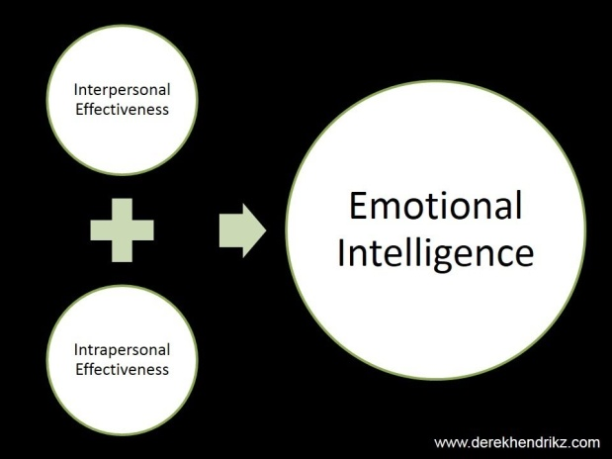
Persons with High EI
I can sense the feelings of others.
I get pleasure in challenges and try to solve them
I am quite sensitive to how relationship goes on
I can easily make acquaintances and friends
I point to the behavior and not to the man during critical comments.
I know how to make a positive emotion last when I experience it

Slide 15
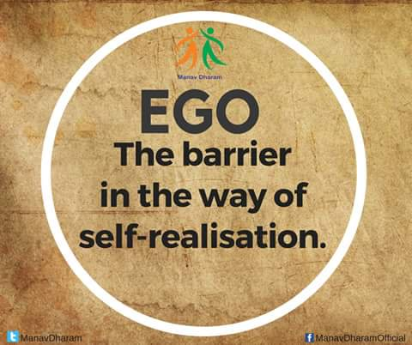
Understanding Self: The barriers…
Blind ambition : Tendency to win at all costs
Unrealistic goals: Setting up goals that are unattainable
Relentless striving: Working hard in a compulsive manner
Insatiable need for recognition: Being addicted to glory; tendency to blame others for own mistakes
Preoccupation with appearances: Being overtly concerned about public image
Need to seem perfect : Inability to tolerate failure

Slide 16
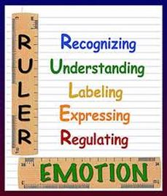
Understanding Self: The purveyor…
Self-awareness: Knowing how you feel in ‘real time’
Emotional literacy: Being able to label emotion precisely
Empathy and compassion: The ability to feel and understand the emotions of others
Balance: Being able to take decision striking a balance between emotion and reason
Responsibility: Taking primary responsibility for your own emotions

Slide 17

How EI helps in decision making
Cognitive skills
Conducting an ‘inner dialogue’
Reading and interpreting social cues
Understanding the perspectives of others
Understanding behavioural norms
Having a positive attitude towards life
Developing realistic expectations

Slide 18
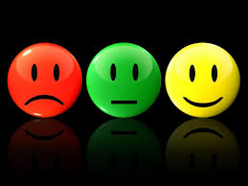
Emotional skills
Expressing, Identifying and labeling feelings
Managing feelings, impulses
Delaying gratification & reducing stress
Knowing the difference between feelings and actions
Behavioural Skills
Nonverbal skills (facial expressions, paralanguage, eye contact, gesture, etc)
Verbal skills (responding effectively to criticism, resisting negative influences)

Slide 19
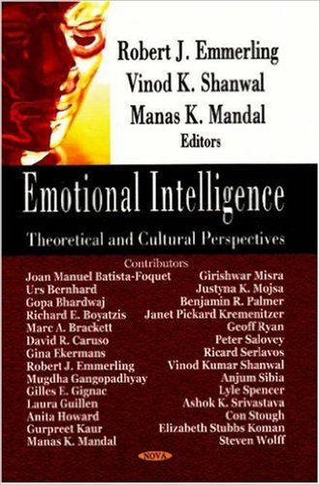
Let us understand ourselves…first & always
http://journals.sagepub.com/doi/10.1177/1470595809335725

